Slide 1
Department of MCA
Programming using C# .Net -22MCA303
Module 2: Classes, Objects and Object Oriented Programming
Handling By
Nirupama K
Asst. Prof. Dept. of MCA

Slide 2
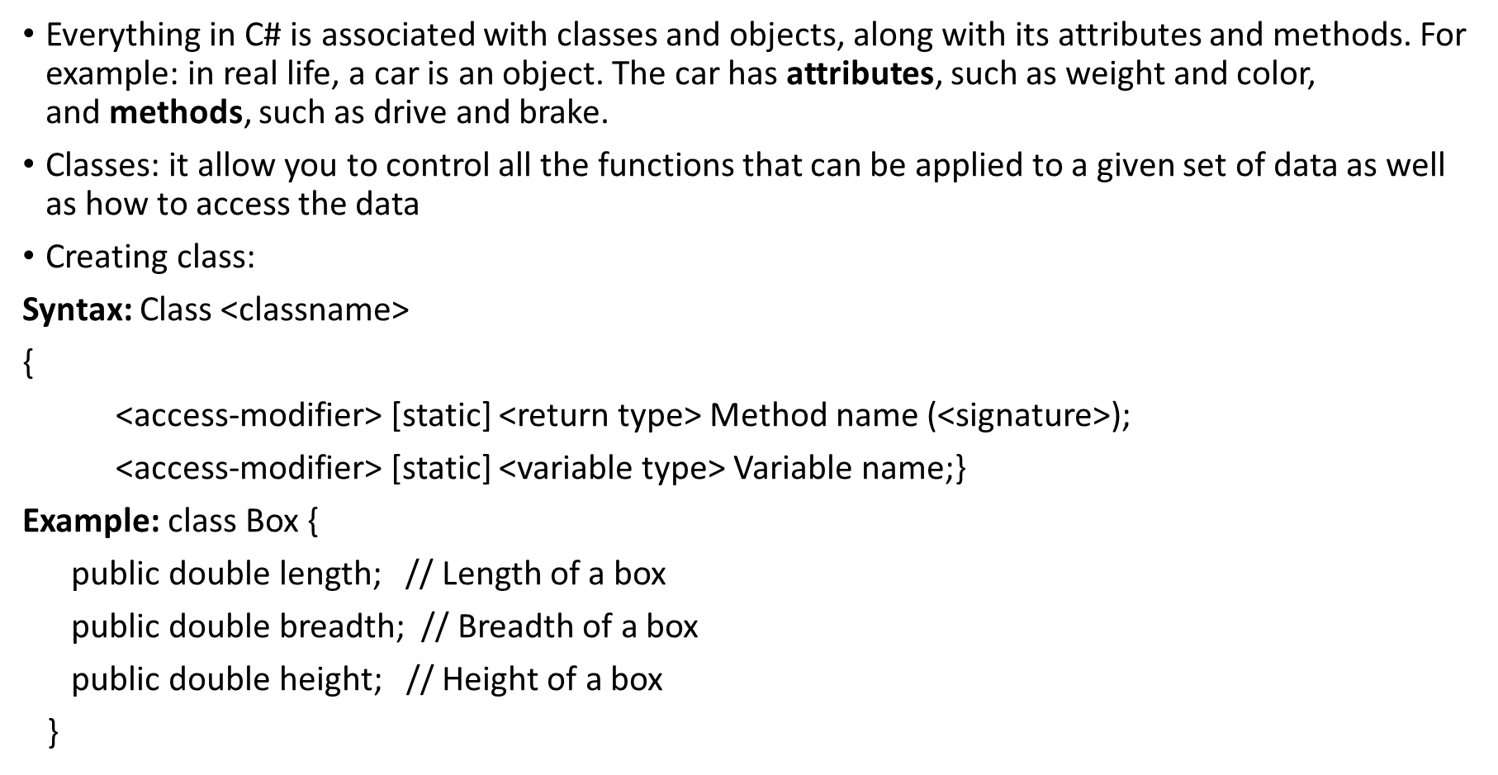
Classes and objects

Slide 3
Creating an Object
Object help you to access the members of a class(fields, methods and properties) by using dot (.) operator
Object is created with new keyword
Syntax: <class name> <object name> = new <class name>();
class Car
{
string color = "red";
static void Main(string[] args)
{ Car myObj = new Car();
Console.WriteLine(myObj.color);
}}

Slide 4
Using this keyword
this keyword refers to the current instance of a class
this keyword cannot be used with static members because static members accessed by a class not by the instances of a class
public class Employee
{
private string alias;
private string name;
public Employee(string name, string alias)
{
// Use this to qualify the members of the class
// instead of the constructor parameters.
this.name = name;
this.alias = alias;
}}

Slide 5
Creating an Array Object
Array of object is different from object of C++ and Java
static public void Main()
{
// Creating and initializing
// object array
object[] arr = new object[6];
arr[0] = 3.899;
arr[1] = 3;
arr[2] = 'g';
arr[3] = "Geeks";
}

Slide 6
Using the Nested Classes
Class within the other class is nested class
class Outer_class {
// Code.. Syntax
class Inner_class {
// Code.. }}
public class Outer_class {
// Method of outer class
public void method1()
{ Console.WriteLine("Outer class method"); }
// Inner class
public class Inner_class {
// Method of inner class
public void method2() {
Console.WriteLine("Inner class Method"); } }}

Slide 7
Defining Partial classes and Methods
In C#, you can split the implementation of a class, a struct, a method, or an interface in multiple .cs files using the partial keyword.
The compiler will combine all the implementation from multiple .cs files when the program is compiled.
public partial class Employee
{
public int EmpId { get; set; }
public string FirstName { get; set; }
public string LastName { get; set; }
public int Age { get; set; }
}

Slide 8
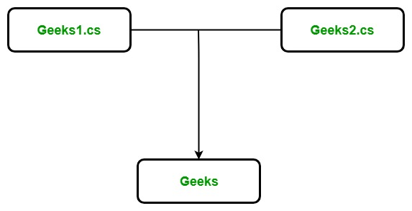
Geeks 1: public partial class Geeks { private string Author_name; private int Total_articles; public Geeks(string a, int t) { this.Authour_name = a; this.Total_articles = t; } } | Geeks 2: public partial class Geeks { public void Display() { Console.WriteLine("Author's name is : " + Author_name); Console.WriteLine("Total number articles is : " + Total_articles); } }

Slide 9
Geeks:
public class Geeks {
private string Author_name;
private int Total_articles;
public Geeks(string a, int t)
{
this.Authour_name = a;
this.Total_articles = t;
}
public void Display()
{
Console.WriteLine("Author's name is : " + Author_name);
Console.WriteLine("Total number articles is : " + Total_articles);
}
}

Slide 10
Using method as class members
<access specifier> class class_name {
// member variables
<access specifier> <data type> variable1;
<access specifier> <data type> variable2;
...
<access specifier> <data type> variableN;
// member methods
<access specifier> <return type> method1(parameter_list) {
// method body
}<access specifier> <return type> method2(parameter_list) {
// method body
}
...
<access specifier> <return type> methodN(parameter_list) {// method body }}

Slide 11
Passing an Object as an Argument to a Method
public void AddOb(Sample S1, Sample S2)
{
//adding the value of S1 and S2,
//assigning sum in value of current object
value = S1.value + S2.value;
}}
class Program
{static void Main()
{//objects creation
Sample S1 = new Sample();
Sample S2 = new Sample();
}

Slide 12
Returning value from method
class ReturnTest
{ static double CalculateArea(int r)
{
double area = r * r * Math.PI;
return area; }
static void Main()
{
int radius = 5;
double result = CalculateArea(radius);
Console.WriteLine("The area is {0:0.00}", result);
// Keep the console open in debug mode.
Console.WriteLine("Press any key to exit.");
Console.ReadKey();}}

Slide 13
Describing the access modifiers
Public Modifier: Allows public access to members both inside and outside a class without any restrictions
Internal Modifier: allow internal access to members. Only the current assembly can access these members
Protected Modifier: Allow protected access members. You can access protected members from either the class in which they are declared or a class derived from the class in which they are declared
Private Modifier: The internal access modifiers can access within the program that contain its declarations
Protected internal modifier:

Slide 14
Properties
class Person
{
private string name; // field
public string Name // property
{
get { return name; } // get method
set { name = value; } // set method
}
}

Slide 15
Read Only Properties
In c#, readonly is a keyword, and it is useful to define read-only fields in our applications.
The read-only field values need to be initialized either at the declaration or in a constructor of the same class, unlike the constant keyword in c#.
readonly data_type field_name = "value";
C# Difference between Constant and ReadOnly
The following are the difference between constant and readonly properties in the c# programming language.
In c#, you can create the constant fields using const keyword and the read-only fields created by using readonly keyword.
In c#, the constant fields are initialized during the declaration, but the read-only fields are initialized either at the declaration or in a constructor.
The constant field values are evaluated during the compile-time, but the read-only field values are evaluated at run time in c#.

Slide 16
Indexers
New concept introduced by C#
It allows you to use a class as an array and enable an object to access the members of a class using an indexer notation
element-type this[int index] {
// The get accessor.
get {
// return the value specified by index}
// The set accessor.
set {
// set the value specified by index }}
Access modifiers, Return type
This keyword shows object of the current class

Slide 17
Argument list specifies parameters of the indexer, in C# must have atleast one parameter list.
Parameter can be of different data type: int, enum or string

Slide 18
Accessibility of Accessors
lass myproperty {
Private string name=“Sumit”;
Public string Name{
Get { return name;}
Set { set= value;}}}
Indexers
This is a new concept introduced by C# // Indexer declaration
public int this[int index]
{
// get and set accessors
}

Slide 19
Struct
Access_Modifier struct structure_name
{
// Fields
// Parameterized constructor
// Constants
// Properties
// Indexers
// Events
// Methods etc.
}

Slide 20
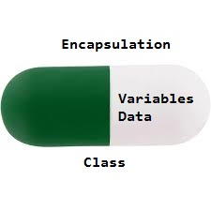
Encapsulation
Encapsulation is a process of hiding the irrelevant data and showing only the relevant information of a specific object to a user
In terms of opps encapsulation is a process of wrapping up of data and member of a class
Provides a way to protect unauthorized access

Slide 21
Inheritance
Most important in C#, promotes for reusability of code and eliminates the redundant code
Inheritance is property through which a class derives properties from other class
A parents class at a higher level I the class hierarchy
<acess-specifier> class <base_class> {
..}
class <derived_class> : <base_class> {
...}
Inheritance is of 4 types
Single inheritance
Hierarchical inheritance
Multi level inheritance
Multiple inheritance

Slide 22
Single Inheritance
Single inheritance usually occurs between two classes – the base class, and the derived class. It occurs when a class is inherited from a single-parent class.
Multiple Inheritance
Multiple inheritance refers to the ability of a class to inherit from multiple base classes. C# does not support multiple inheritance of classes, but it does support
multiple inheritance using interfaces. An interface is a collection of abstract methods that a class can implement to provide specific behavior. A class can
implement multiple interfaces, which allows it to inherit functionality from multiple sources.
Hierarchical inheritance
In C#, Hierarchical Inheritance is a type of inheritance where a derived class can inherit from a single base class, but the derived class can also act as a base class for other classes.

Slide 23
Inheritance and constructor
Constructor is a special method of a class
A constructor is called by default whenever an object of a class is created
All the derived classes have their default constructor
The default constructor of a base class is called automatically and then the derived class constructor is called
Sealed class

Slide 24
Extension Method
Extension method is a method that helps you to extend a class without creating a new derived class or modifying the original class
public static class Demo
{ public static int myExtensionMethod(this string str)
{
return Int32.Parse(str);} }
class Program
{
static void Main(string[] args)
{
string str1 = "565";
int n = str1.myExtensionMethod();
Console.WriteLine("Result: {0}", n);
Console.ReadLine();}

Slide 25
Polymorphism
This is one of the important feature of OOPs
That is used to exhibit different forms of a particular procedure
Allows you to invoke methods of a derived class through base class reference during runtime
Provides different implementation of methods in a class that are called through the same name
There are 2 types of polymorphism
Static polymorphism/ compile time polymorphism/ overloading
Dynamic polymorphism/ run time polymorphism/ overriding

Slide 26
class Animal // Base class (parent)
{
public void animalSound()
{
Console.WriteLine("The animal makes a sound");
}}
class Pig : Animal // Derived class (child)
{ public void animalSound()
{
Console.WriteLine("The pig says: wee wee");
}}
class Dog : Animal // Derived class (child)
{ public void animalSound()
{ Console.WriteLine("The dog says: bow wow");
}}

Slide 27
Static polymorphism/ compile time polymorphism/ overloading
Method overloading
Method Overloading is the common way of implementing polymorphism. It is the ability to redefine a function in more than one form. A user can implement function overloading by defining two or more functions in a class sharing the same name
public class Calculate
{public void AddNumbers(int a, int b)
{Console.WriteLine("a + b = {0}", a + b);
}
public void AddNumbers(int a, int b, int c)
{Console.WriteLine("a + b + c = {0}", a + b + c);
}
}
Indexer overloading

Slide 28
Dynamic polymorphism/ run time polymorphism/ overriding
C# allows you to create abstract classes that are used to provide partial class implementation of an interface. Implementation is completed when a derived class inherits from it
Dynamic polymorphism also referred to as run-time or late binding polymorphism because of the decision about which method is to be called is made at run time.
In dynamic polymorphism, we override the base class method in derived class using inheritance, and this can be achieved using override and virtual keywords.
Virtual keyword is used for generating a virtual path for its derived classes on implementing method overriding. Virtual keyword is used within a set with override keyword. It is used as:
// Base Class
class A
{
public virtual void show()
{ Console.WriteLine("Hello: Base Class!");
Console.ReadLine(); }}

Slide 29
Override Keyword
Override keyword is used in the derived class of the base class in order to override the base class method. Override keyword is used with virtual keyword, as:
// Base Class
class A
{
public virtual void show()
{
Console.WriteLine("Hello: Base Class!");
Console.ReadLine(); }}
// Derived Class
class B : A
{
public override void show()
{ Console.WriteLine("Hello: Derived Class!");
Console.ReadLine();}}

Slide 30
Abstraction
Abstraction is the process of hiding the details of a particular concept or object
Abstract classes
Abstract class can not be instantiated
abstract class Base class
{
//Data member and member function
}
Class Derived class: BaseClass
{//Data member and member function}
Class MainClass()
{Base class bc; // cant be instantiated
Derived class dc; // can be instantiated

Slide 31
Characteristics of abstract class
Restricts instantiation implying that you cannot create on object of an abstract class
Allows you to define abstract as well as non-abstract members in it
Requires at least one abstract method in it
Restricts the use sealed keyword in it
Possesses public access specifier; therefore it can be used any where in a program
Abstract Method
An abstract method is similar to virtual method which does not provide any implementation
Public abstract void area (int Length, int breadth)
abstract class Animal
{
public abstract void animalSound();
public void sleep()
{ Console.WriteLine("Zzz");}}

